Slide 1
String Objects in javascript
By: PARUL MADAN(CSE)
GEU

Slide 2
String objects
The String object lets you work with a series of characters; it wraps JavaScript's string primitive data type with a number of helper methods.
As JavaScript automatically converts between string primitives and String objects, you can call any of the helper methods of the String object on a string primitive.
Syntax:
Var str=“John Doe”; or Var str=‘John Doe’;
Var str1=“it’s all right”;
Var str2=‘it\’s all right’
Var str3=“first_name\\second_name”;

Slide 3
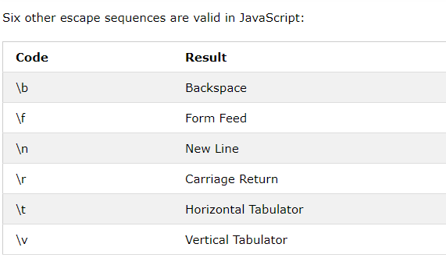

Slide 4
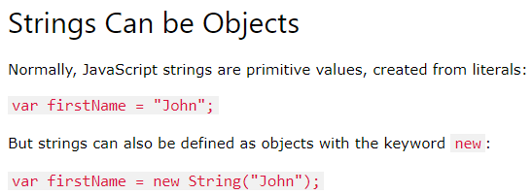

Slide 5
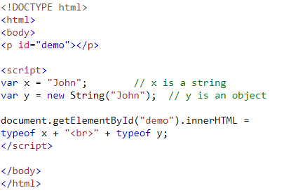

Slide 6
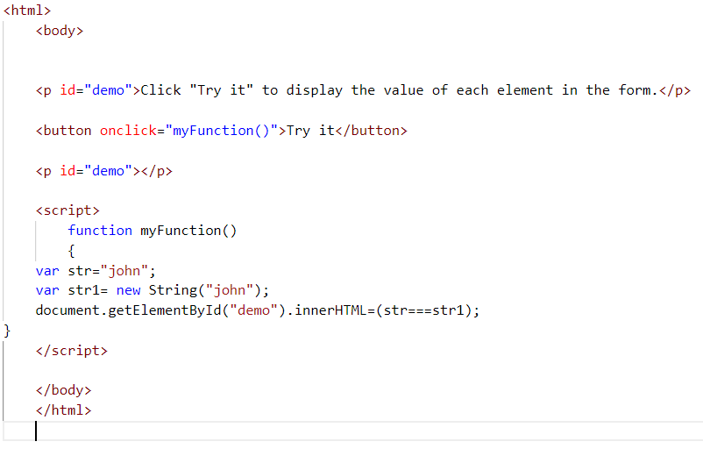

Slide 7
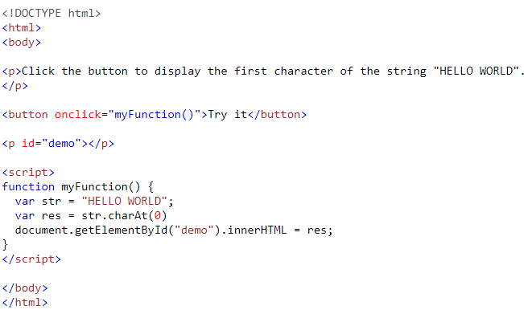
Javascript string methods
1. charAt()

Slide 8
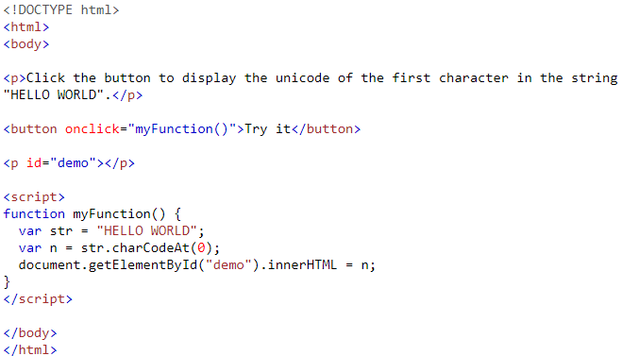
charCodeAt()

Slide 9
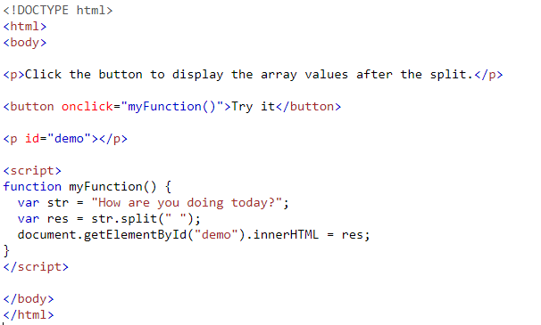
split()

Slide 10
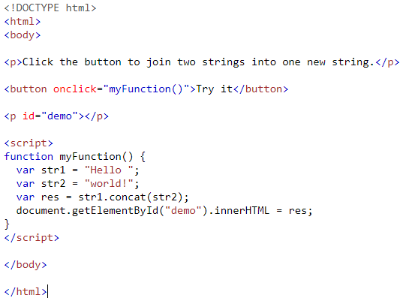
concat()

Slide 11
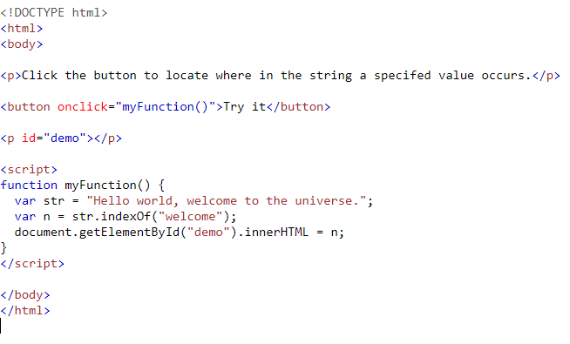
indexOf()

Slide 12
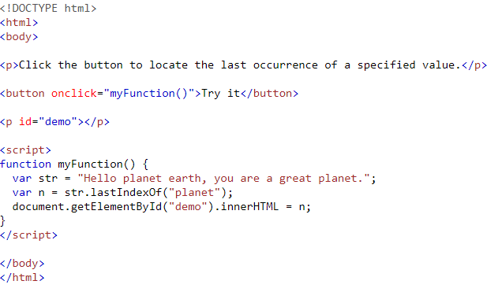
lastIndexOf()

Slide 13
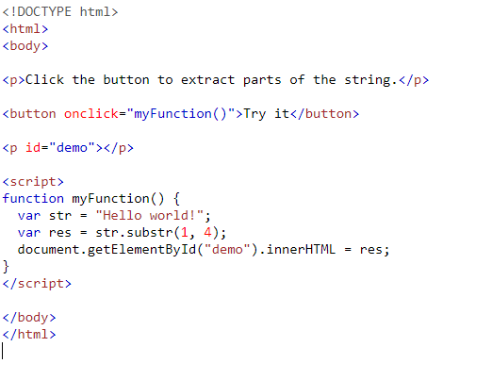
substr()

Slide 14
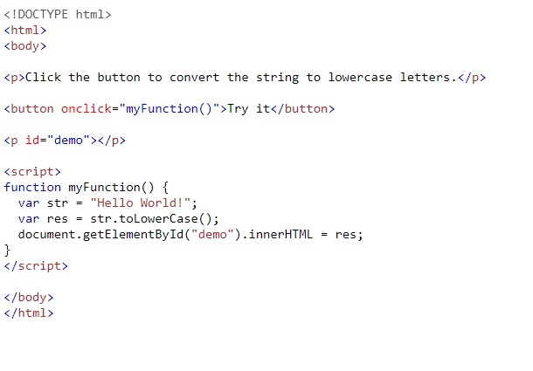
toLowerCase()

Slide 15
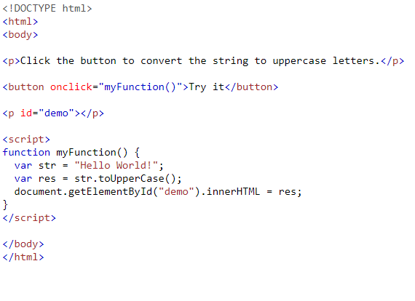
toUpperCase()

Slide 16
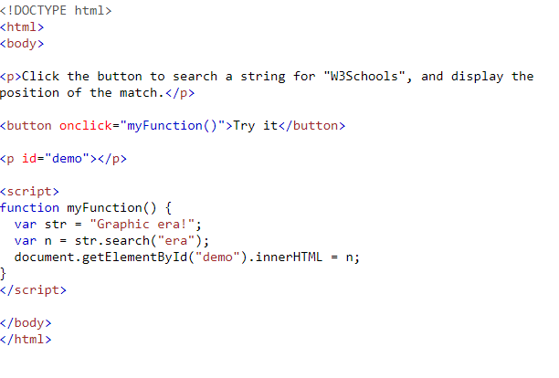
search()

Slide 17
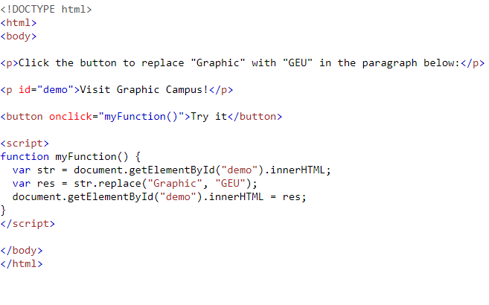
replace()

Slide 18
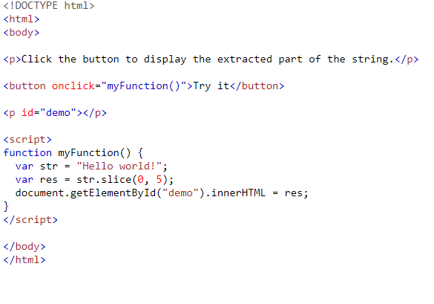
slice()

Slide 19
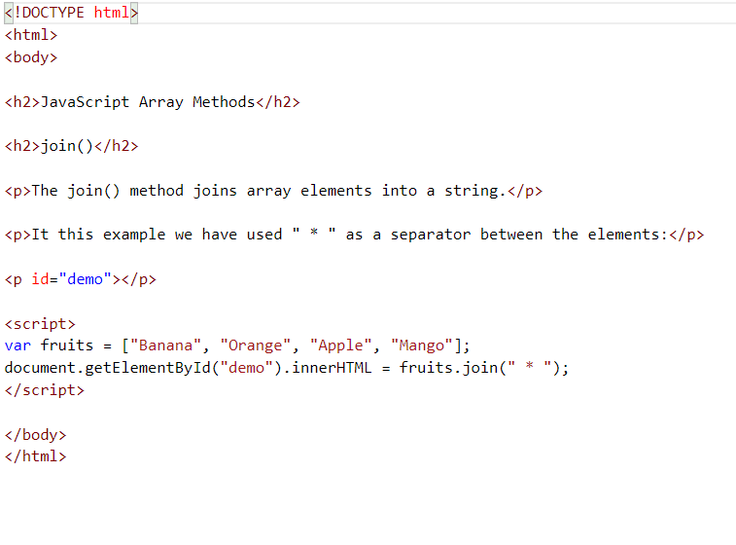
Join()coverts array elements to string

Slide 20
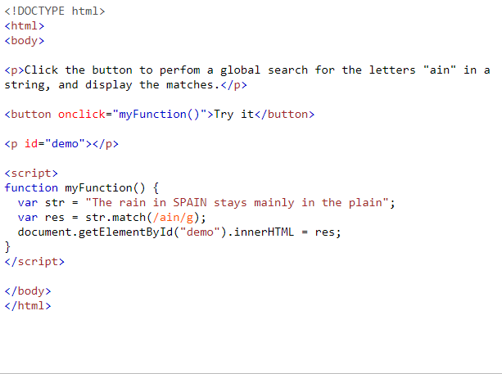
match()

